Slide 1
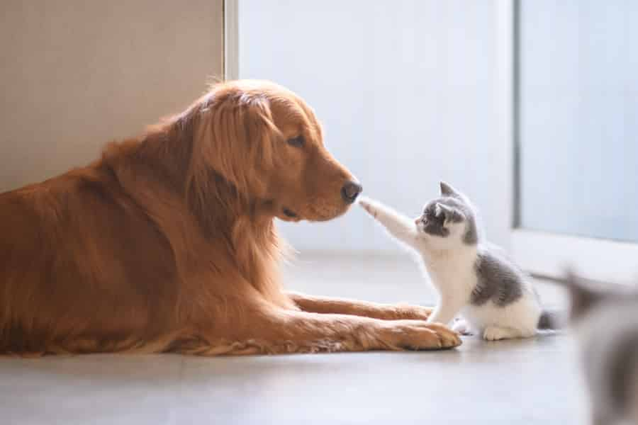
Capstone Project-Austin Animal Center
How to Find Animals a Sweet Home?

Slide 2
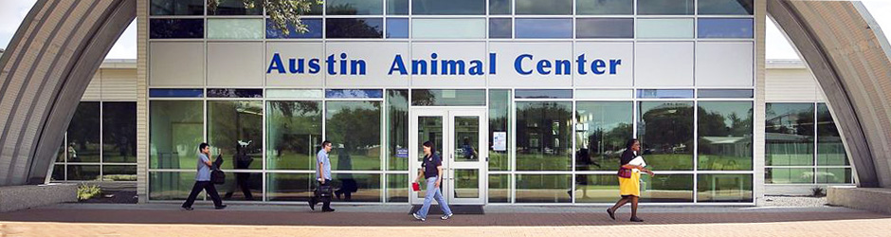
Largest no-kill animal shelter in United States
Provide care and shelter for over 16000 animals every year
The goal is to place all adoptable animals in forever homes
Find best strategy to allocate resource

Slide 3


Data Sources
Open database acquired by Kaggle from Austin’s Open Data Initiatives
Austin Center Intakes.csv
Animal_id, age, sex, intake_types, intake_conditions, found_location, color, breed, time
Austin Center Outcomes.csv
Animal_id, age, sex, outcome_types, time, color, breed, outcome_conditions, time_in_shelter
Conbined Dataset

Slide 4
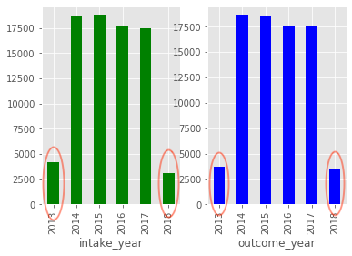
Data Wrangling
Import the Dataset
Drop data with missing value of sex column
Replace missing value with ‘Normal’ of condition column
Drop data of 2013 and 2018
Only several months of year 2013 and 2018 are included

Slide 5
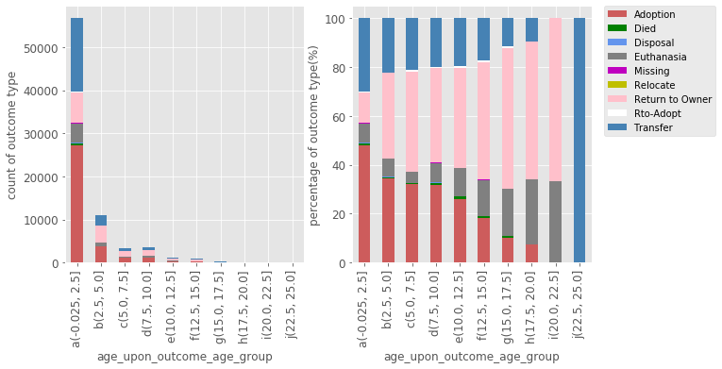
Data Exploratory- Younger age are more popular
Animal center can post animals pictures of younger animals, which can attract more people for adoption
Over 85% animals are younger than 2.5 years old
The adoption rate of youngest age group is highest
The adoption rate drops as age groups become older

Slide 6
Data Exploratory- June to August is good time
The adoption rate peak is from June to August every year
The animal center can hire more volunteers and post more advertise to encourage adoption

Slide 7
Data Exploratory- Neuter helps adoption
More than 75% neutered animals were adopted.
Animal center should neuter eligible animals to help them being adopted.

Slide 8
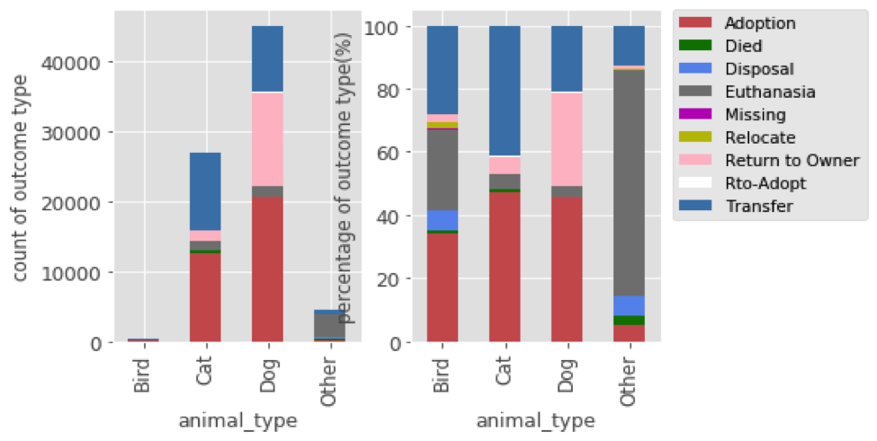
Data Exploratory- Dogs are more likely to find owner
The adoption rate of cats and dogs are similar
The return to owner rate of dogs are almost four times of cats
Animal center can spend more effort to help dogs find original owner

Slide 9
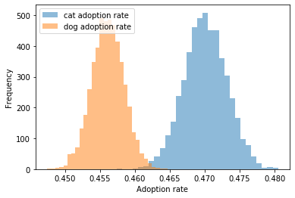
Statistical Data Analysis- Difference of cats and dogs adoption
The p-value and bootstrap plot is enough to prove cat adoption rate is higher than dog adoption rate
p-value=0

Slide 10
Machine Learning
Goal
Predict the outcome type(adoption, euthanasia, return to owner, transfer), and post animal info to target owner.
Models
Knn
SVM
Stacking Model
Random Forest

Slide 11
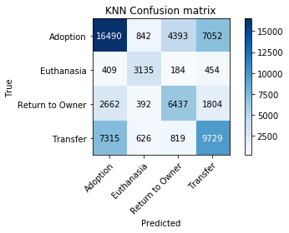
K-Nearest Neighbors
 | precision | recall | f1-score | support
Adoption | 0.61 | 0.57 | 0.59 | 28777
Euthanasia | 0.63 | 0.75 | 0.68 | 4182
Return to Owner | 0.54 | 0.57 | 0.56 | 11295
Transfer | 0.51 | 0.53 | 0.52 | 18489
accuracy |  |  | 0.57 | 62743
macro avg | 0.57 | 0.6 | 0.59 | 62743
weighted avg | 0.57 | 0.57 | 0.57 | 62743

Slide 12
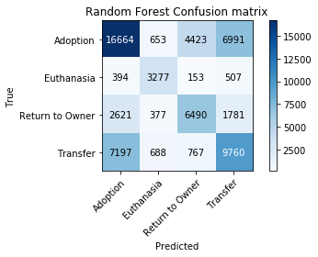
Random Forest
 | precision | recall | f1-score | support
Adoption | 0.62 | 0.58 | 0.6 | 28731
Euthanasia | 0.66 | 0.76 | 0.7 | 4331
Return to Owner | 0.55 | 0.58 | 0.56 | 11269
Transfer | 0.51 | 0.53 | 0.52 | 18412
accuracy |  |  | 0.58 | 62743
macro avg | 0.58 | 0.61 | 0.6 | 62743
weighted avg | 0.58 | 0.58 | 0.58 | 62743

Slide 13

Support Vector Machine
 | precision | recall | f1-score | support
Adoption | 0.62 | 0.58 | 0.6 | 28605
Euthanasia | 0.65 | 0.77 | 0.71 | 4241
Return to Owner | 0.55 | 0.58 | 0.56 | 11205
Transfer | 0.52 | 0.53 | 0.52 | 18692
accuracy |  |  | 0.58 | 62743
macro avg | 0.58 | 0.61 | 0.6 | 62743
weighted avg | 0.58 | 0.58 | 0.58 | 62743

Slide 14
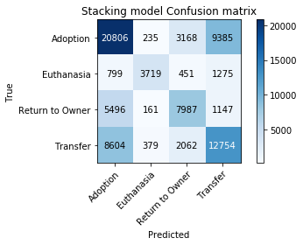
Stacking Model
 | precision | recall | f1-score | support
Adoption | 0.58 | 0.62 | 0.6 | 33594
Euthanasia | 0.83 | 0.6 | 0.69 | 6244
Return to Owner | 0.58 | 0.54 | 0.56 | 14791
Transfer | 0.52 | 0.54 | 0.53 | 23799
accuracy |  |  | 0.58 | 78428
macro avg | 0.63 | 0.57 | 0.6 | 78428
weighted avg | 0.58 | 0.58 | 0.58 | 78428

Slide 15
Conclusion
The animal center should be preparing for contain and feed at least 2000 animals, 57% of which are dogs, 40% of which are cats and 3% are birds and other animals.
People tend to adopt animals at younger age, and dogs are more likely to be returned to owner.
More animals were adopted from June to August than other months
Neutered animals are more likely to be adopted
Random forest model and SVM model have better performance to predict the animal outcome

